Slide 1
Introduction/Background
Sign languages are way of communicating techniques mostly where hearing impaired community uses throughout the world.
The most frequent technique of signing words and sentences is by waving fingers, arms, hands, and making motions with face.
Sign languages are complete languages with vocabulary, grammar which has unique characteristics.
Several factors are employed to identify signs, including hand orientations with many forms, movement of hands, posture of body, and expressions in faces.

Slide 2
Purpose
The purpose of sign language interpretation systems is to use techniques like vision to automatically translate sign languages.
The two main goals in this technique are word-level sign language recognition (also known as "isolated sign language recognition") and sentence-level sign language recognition (also known as "continuous sign language recognition").

Slide 3
Literature Review
The current methods for continuous SLR while using isolated SLR as building blocks also add layers of pre-processing and post-processing which indicate temporal segmentation and sentence synthesis respectively.
Continuous SLR being more challenging involves reconstructing sentence structures, which divide the problem of recognizing sentences into three stages which are segmentation of videos with time, recognizing isolated word/expression, and sentence synthesis with a language model.
Most approaches in the recent past show great progress in Sign Language Recognition which are based on the Hidden Markov Model (HMM) with various features such as motion trajectory.

Slide 4
Literature Review (contd..)
The temporal segmentation even though popular is difficult to implement due to reasons where transitional movement between hand gestures can be subtle and ambiguous leading to inaccurate segmentation.
An end-to-end novel sequence-to-sequence model that can generate video captions is a relevant research area.
The state-of-the-art performance demonstrated by Recurrent Neural Networks, specifically LSTMs in generating image captions, is trained on pairs of video-sentence and the model associates a sequence of video frames to sequence of words to describe an event in the video clip.

Slide 5
Problem Statement
The main aim of this research is to propose a model that will perform Sign Language Recognition.
Given a video with a person performing Sign Language for words, our model will recognize the video and will classify that video into one of the elements in vocab space.

Slide 6
Datasets
Indian Lexicon Sign Language Dataset - INCLUDE - an ISL (Indian Sign Language) dataset contains 0.27 million frames across 4287 videos over 263-word signs from 15 different word categories.
Word-Level American Sign Language (WLASL) video dataset with more than 2000 words performed by more than 100 signers.
A new large-scale multi-modal Turkish Sign Language dataset (AUTSL). There are over 38000 video samples, which includes over 200 signs by more than 40 individual signers.

Slide 7
Methodology
Method 1: 3D CNN based Classification with Softmax in the last layer - Convolutional Neural Networks (CNN) is used in a variety of applications. It is, without a doubt, the most widely used deep learning architecture. CNN has become the go-to model for any image-related issue. They outperform the competitors in terms of accuracy.
Method 2: VGG Feature Extraction + 2D CNN based Classification - VGG16 is a CNN (Convolutional Neural Network) that is widely regarded as one of the best computer vision models available today. The creators of this model analyzed the networks and enhanced the depth using architecture with very small (3x3) convolution filters, which outperformed previous-art setups significantly.

Slide 8
Methodology (contd..)
Method 3: Method 1/Method 2 with Attention mechanism - The study that established the now-famous "Attention Mechanism“ has evolved and is recognized as "Bahdanau Attention“.
Method 4: VGG Features + Transformer’s Encoder + GRU based Decoder - Due to advances in Sequence Modelling, such as the comeback of Long-Short Term Memory networks (LSTMs) and the development of Gated Recurrent Units (GRUs), generating captions in videos and summarizing them have been recently popular.
Method 5: I3D Pretrained/Video Vision Transformer + Transformer’s Encoder + GRU based Decoder - The preprocessing techniques on video data include - VGG (Visual Geometry Group) Feature Extraction, and I3D (Inflated 3D ConvNet) Feature Extraction & Vision Transformer.

Slide 9
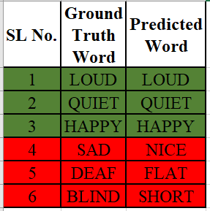
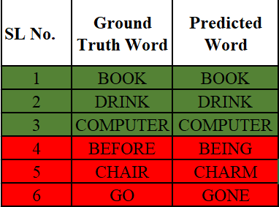
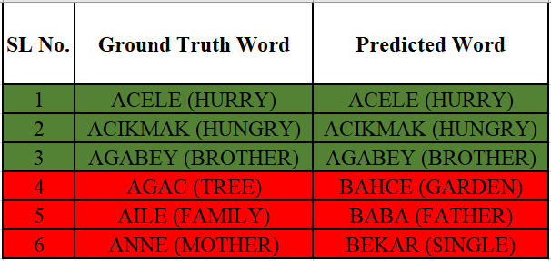
Qualitative and Quantitative Results
Method 1: INCLUDE Method 1: WLASL Method 1: AUTSL
Accuracy:
INCLUDE: 60%
WLASL: 26%
AUTSL: 76%

Slide 10
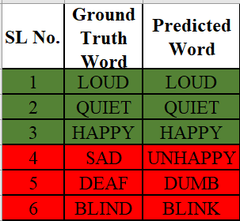
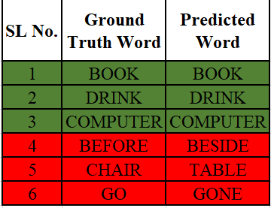
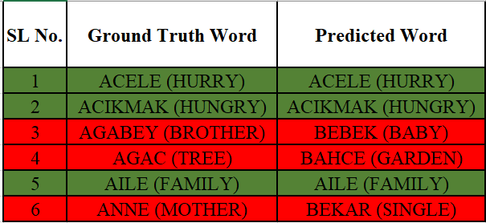
Qualitative and Quantitative Results
Method 2: INCLUDE Method 2: WLASL Method 2: AUTSL
Accuracy:
INCLUDE: 63%
WLASL: 28%
AUTSL: 78%

Slide 11
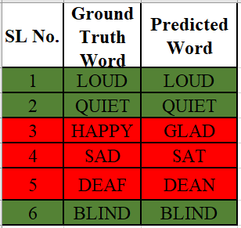
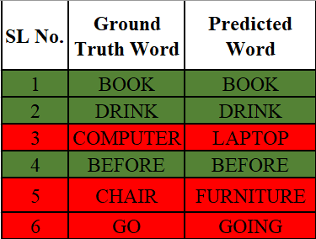
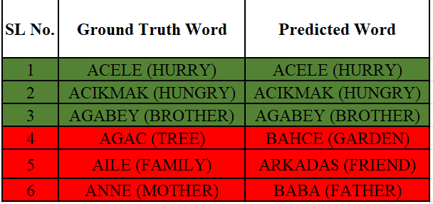
Qualitative and Quantitative Results
Method 3: INCLUDE Method 3: WLASL Method 3: AUTSL
Accuracy:
INCLUDE: 65%
WLASL: 31%
AUTSL: 82%

Slide 12
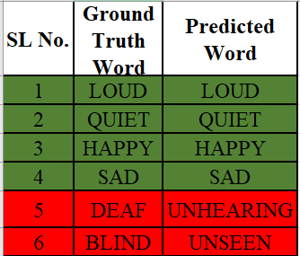
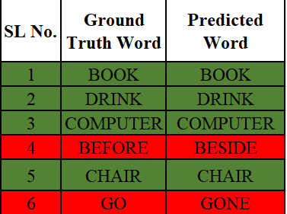
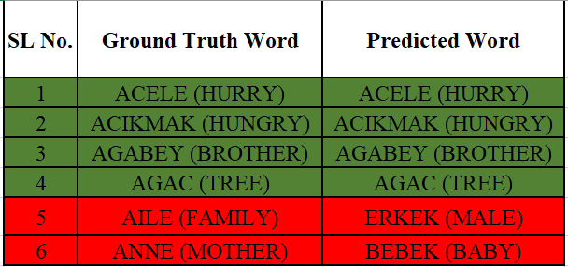
Qualitative and Quantitative Results
Method 4: INCLUDE Method 4: WLASL Method 4: AUTSL
Accuracy:
INCLUDE: 89%
WLASL: 32%
AUTSL: 86%

Slide 13
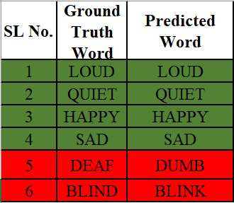
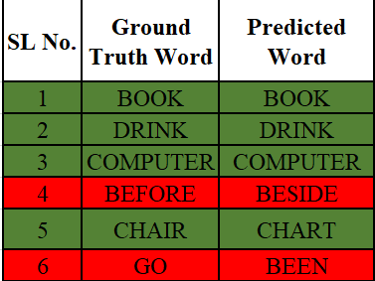
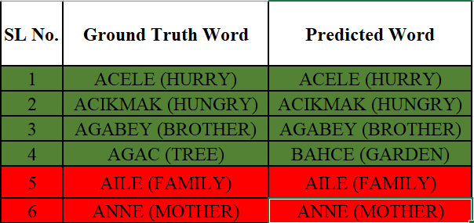
Qualitative and Quantitative Results
Method 5: INCLUDE Method 5: WLASL Method 5: AUTSL
Accuracy:
INCLUDE: 98%
WLASL: 35%
AUTSL: 96%
**Method 5: I3D performed best out of all the methods**

Slide 14
Conclusion
The deep learning-based vision-based suggested models for sign language recognition and related fields were looked at over the previous five years.
The primary objective is to succinctly summarize the vision-based sign language recognition models that correlate to the results obtained.
Gave a succinct overview of the sign language recognition application domain.
More information about this domain must be investigated to open new doors for suggesting certain applications compatible with real-world circumstances because of the importance of this domain to the deaf and speak-impaired community.

Slide 15
Future Recommendation
Even though numerous models have been put forth for the recognition of sign language, more work is still needed to produce models that are more precise and practical.
Most of the difficulties in the field of sign language recognition, according to our predictions, will be overcome with the aid of deep learning, faster hardware to process the input data, precise multi-modal methods, and fresh data illustrating the true variability and distribution of the problem at hand.
Although most of the models that have been presented are focused on isolated sign language recognition, we anticipate that the community will soon begin to address the difficulties of continuous sign language recognition, including continuous annotated datasets, tokenization, and long-term multi-modal data modelling, particularly by combining vision and language models.

Slide 16
Acknowledgement
I want to thank Seshadri Mazumder for supervising my thesis work that started right from the phase of choosing the topic, framing the research proposal, interim report till producing the final thesis. This work would not have been possible without his support. Also thankful to LJMU faculty – Dr Manoj Jayabalan and Dr Ahmed Kaky for all those live sessions which helped me plan my work better and for answering all my questions with patience

Slide 17
THANK YOU

